Slide 1
Supply Chain Management I
Computer Systems Management
Module Code CT012-3-3
Level 3
VD1

Slide 2
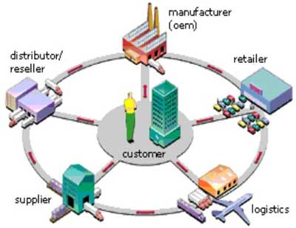
Learning Outcomes
Supply Chain (SC)
Value Chain
Supply Chain Management (SCM)
Bullwhip Effect
Duties and Tariffs

Slide 3
Content
Supply Chain (SC)
Supply Chain Management (SCM)
Supply Chain Benefits
Bullwhip Effect
Duties and Tariffs
RFID

Slide 4
Key Terms
Supply Chain (SC)
Supply Chain Management (SCM)
Bullwhip Effect
Duties and Tariffs

Slide 5
Supply Chain
All stages involved directly or indirectly in
fulfilling customer request e.g. manufacturers, suppliers, transporters, warehouses, retailers, customers
Within each company, SC includes all functions in fulfilling a customer request - product development, marketing, operations, distribution, finance, customer service

Slide 6
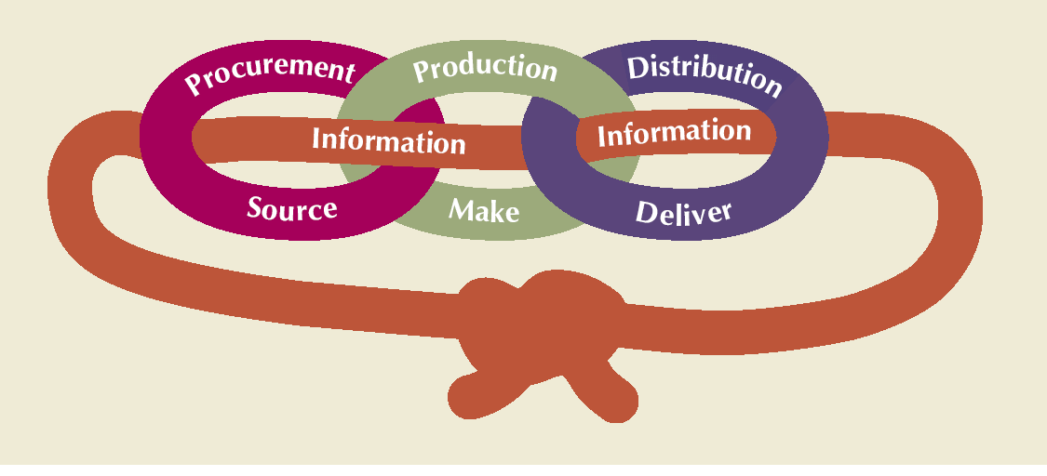
Supply Chain
May be more accurate to use the term “supply network” or “supply web”
An integrated group of processes to “source,” “make,” and “deliver” products

Slide 7
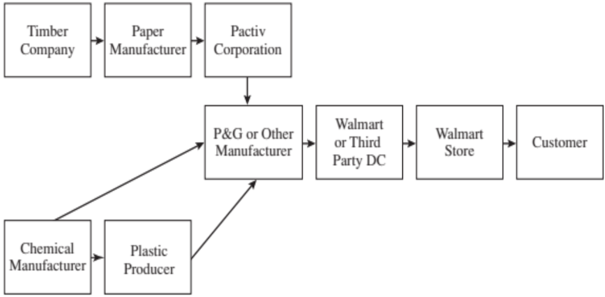
Supply Chain - Walmart

Slide 8
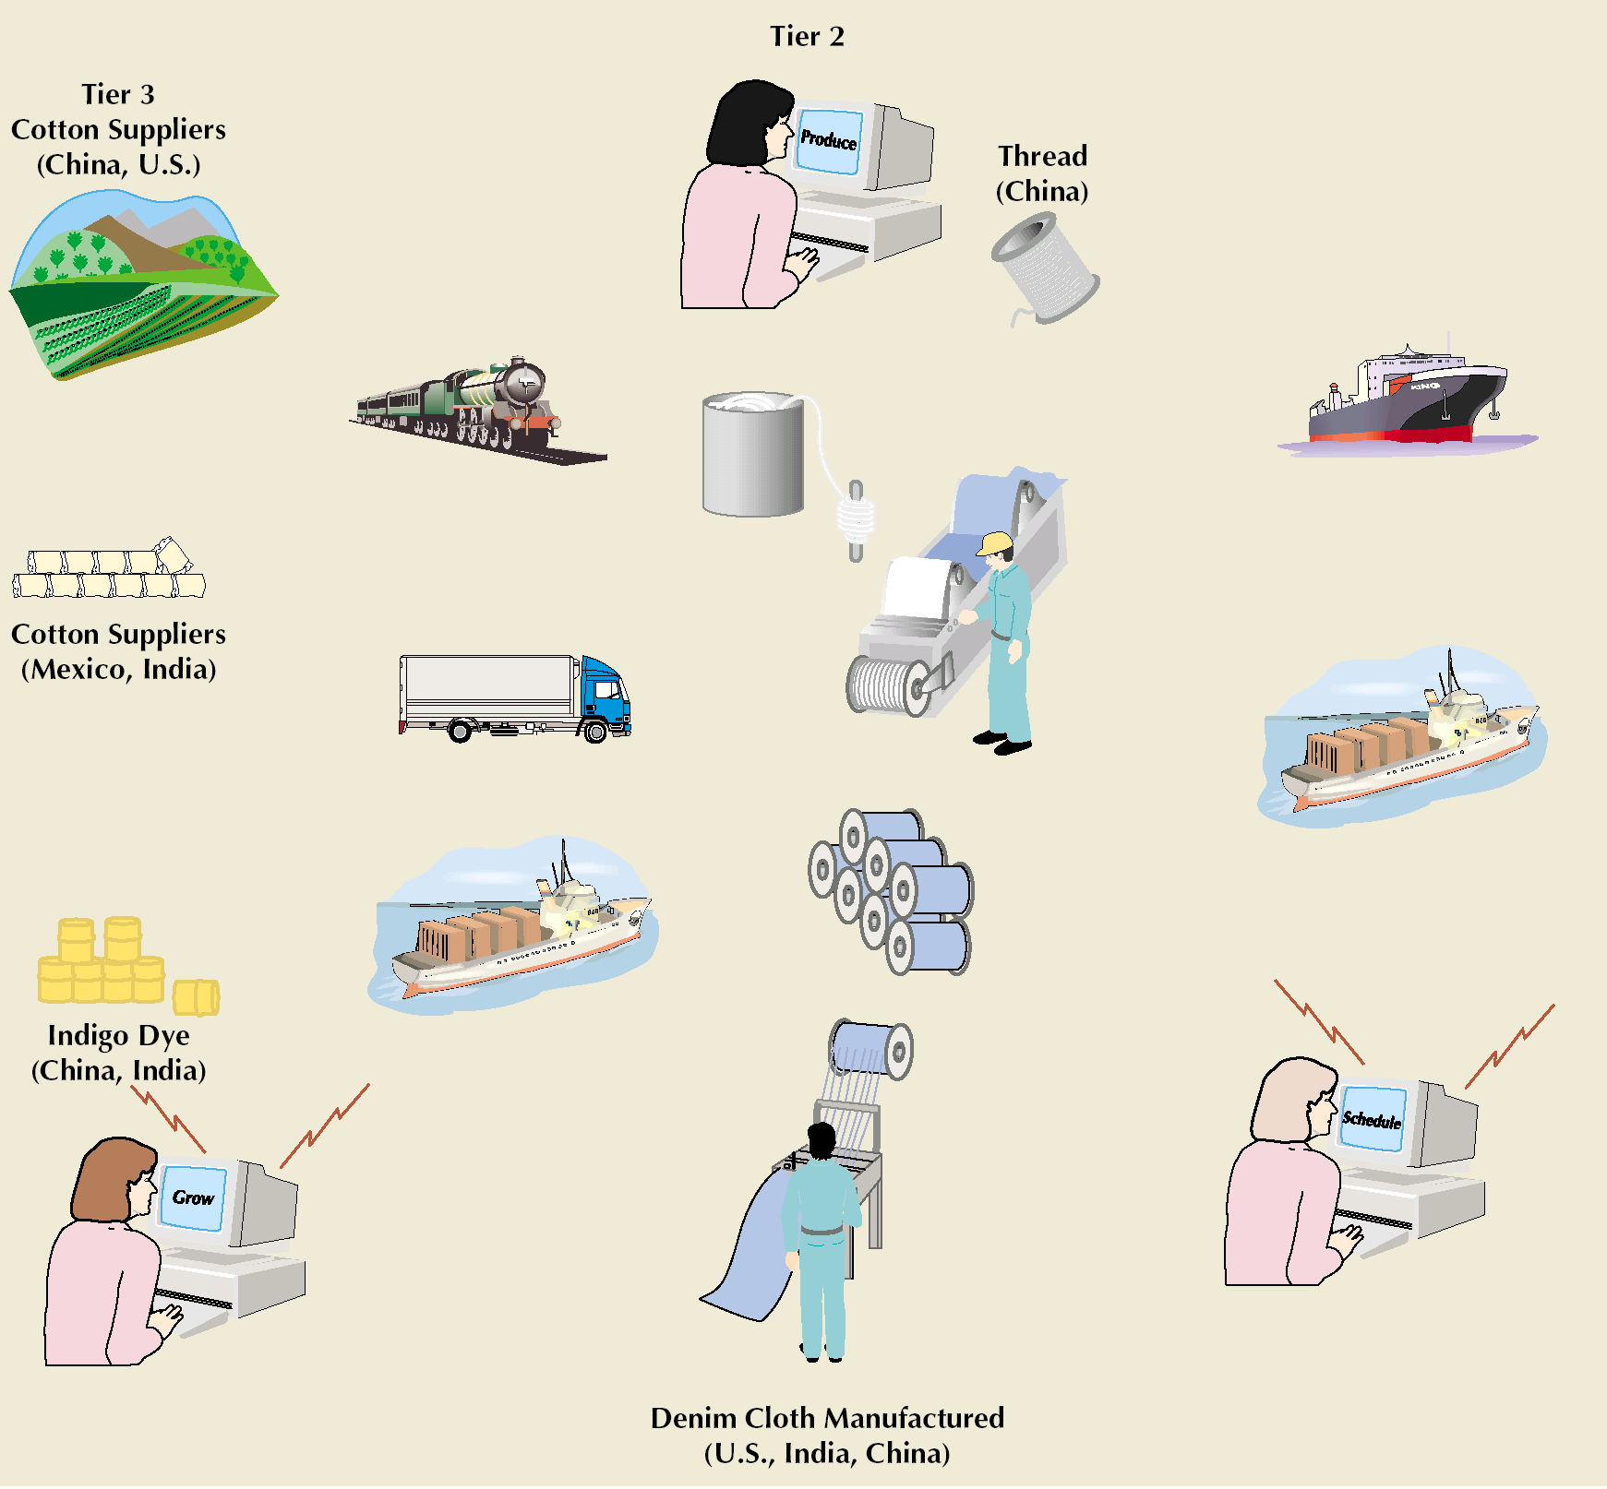

Supply Chain for Denim Jeans

Slide 9
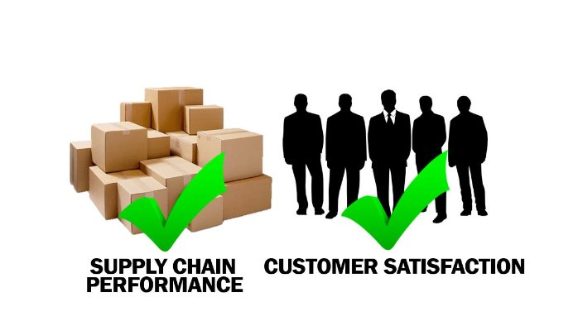
Supply Chain Objectives
Customer satisfaction - customer the only source of revenue
Maximize overall value generated
SC profitability is total profit to be shared across all stages of SC
Success measured by total SC profitability, not profit at individual stage

Slide 10
Value vs. Supply Chain
Value chain – Primary Activities
Where materials are purchased, processed into products and delivered to customers e.g.
Inbound Logistics (input)
Operations (manufacturing + testing)
Outbound Logistics (storage + distribution)
Marketing & Sales 5. Service (after sales)
Value added at each activity e.g. quality input, test for defects, market product and after sales service or warranties
Value chain – Support Activities
Firm’s infrastructure (accounting, management, finance, IT)
Human Resource
Technology development (R&D) 4. Procurement

Slide 11
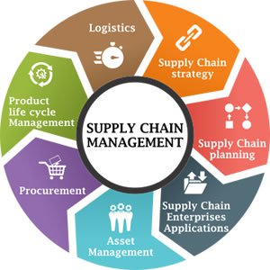
Supply Chain Management
Managing the flow of information through SC in order to attain the level of synchronization that will make it more responsive to customer needs while lowering costs
  Goal of SC Management - respond to uncertainty in customer demand without creating costly excess inventory
Keys to effective SCM
  information
  communication
  cooperation
  trust

Slide 12
Supply Chain Uncertainty
Uncertainty Factors
  inaccurate demand forecasting
  long variable lead times (number of minutes/hours days allowed for the completion of a process or before a desired action takes place)
  late deliveries
  incomplete shipments
  product changes batch ordering
  price fluctuations and discounts
  inflated orders
Uncertainty Impact
  Lateness and incomplete orders
  Inventory insurance against SC uncertainty

Slide 13
Bullwhip Effect
Fluctuations in orders increase as they
move up the SC from retailers to wholesalers to manufacturers to suppliers
Distorts demand information within the SC from
a loss of coordination
Example: Pampers manufacturer had unpredictable orders from its distributors that created production + inventory problems owing to poor forecasting
Solution: Information sharing along the SC via extranets, Groupware. Example: Kimberly-Clark & WalMart share inventory updates

Slide 14
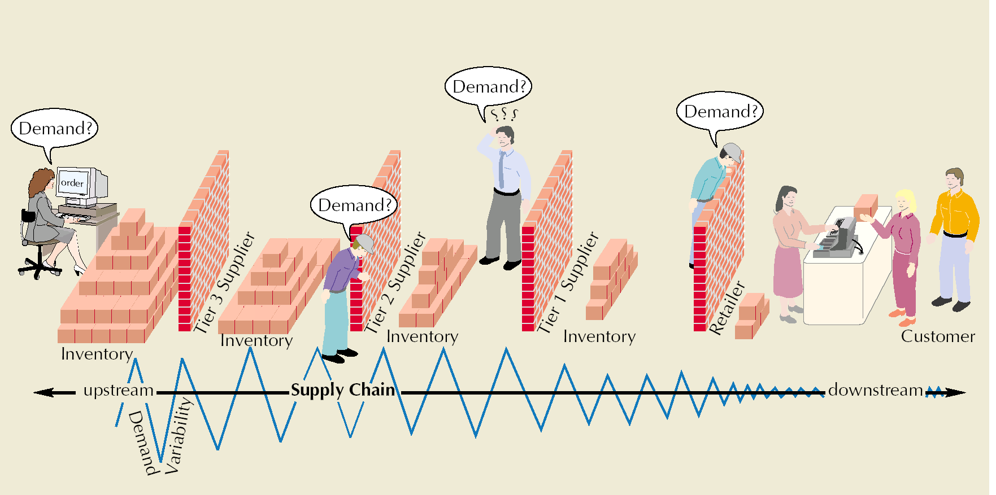
Bullwhip Effect
Performance Measure | Impact of the Lack of Coordination
Manufacturing cost | Increases
Inventory cost | Increases
Replenishment lead time | Increases
Transportation cost | Increases
Shipping and receiving cost | Increases
Level of product availability | Decreases
Profitability | Decreases

Slide 15
IT: A Supply Chain Enabler
E-business – electronic online processes
Electronic Data Interchange (EDI)
  a computer-to-computer exchange of business documents in standard electronic format between companies, moving away from paper-based
Bar code and Point-of-sale
  Instantaneous computer record of a sale
Radio Frequency Identification (RFID)
Technology that uses electronic tags on objects, people, animals to track them by radio waves
Internet
  companies communicate with suppliers, customers, shippers and other businesses around the world instantaneously

Slide 16
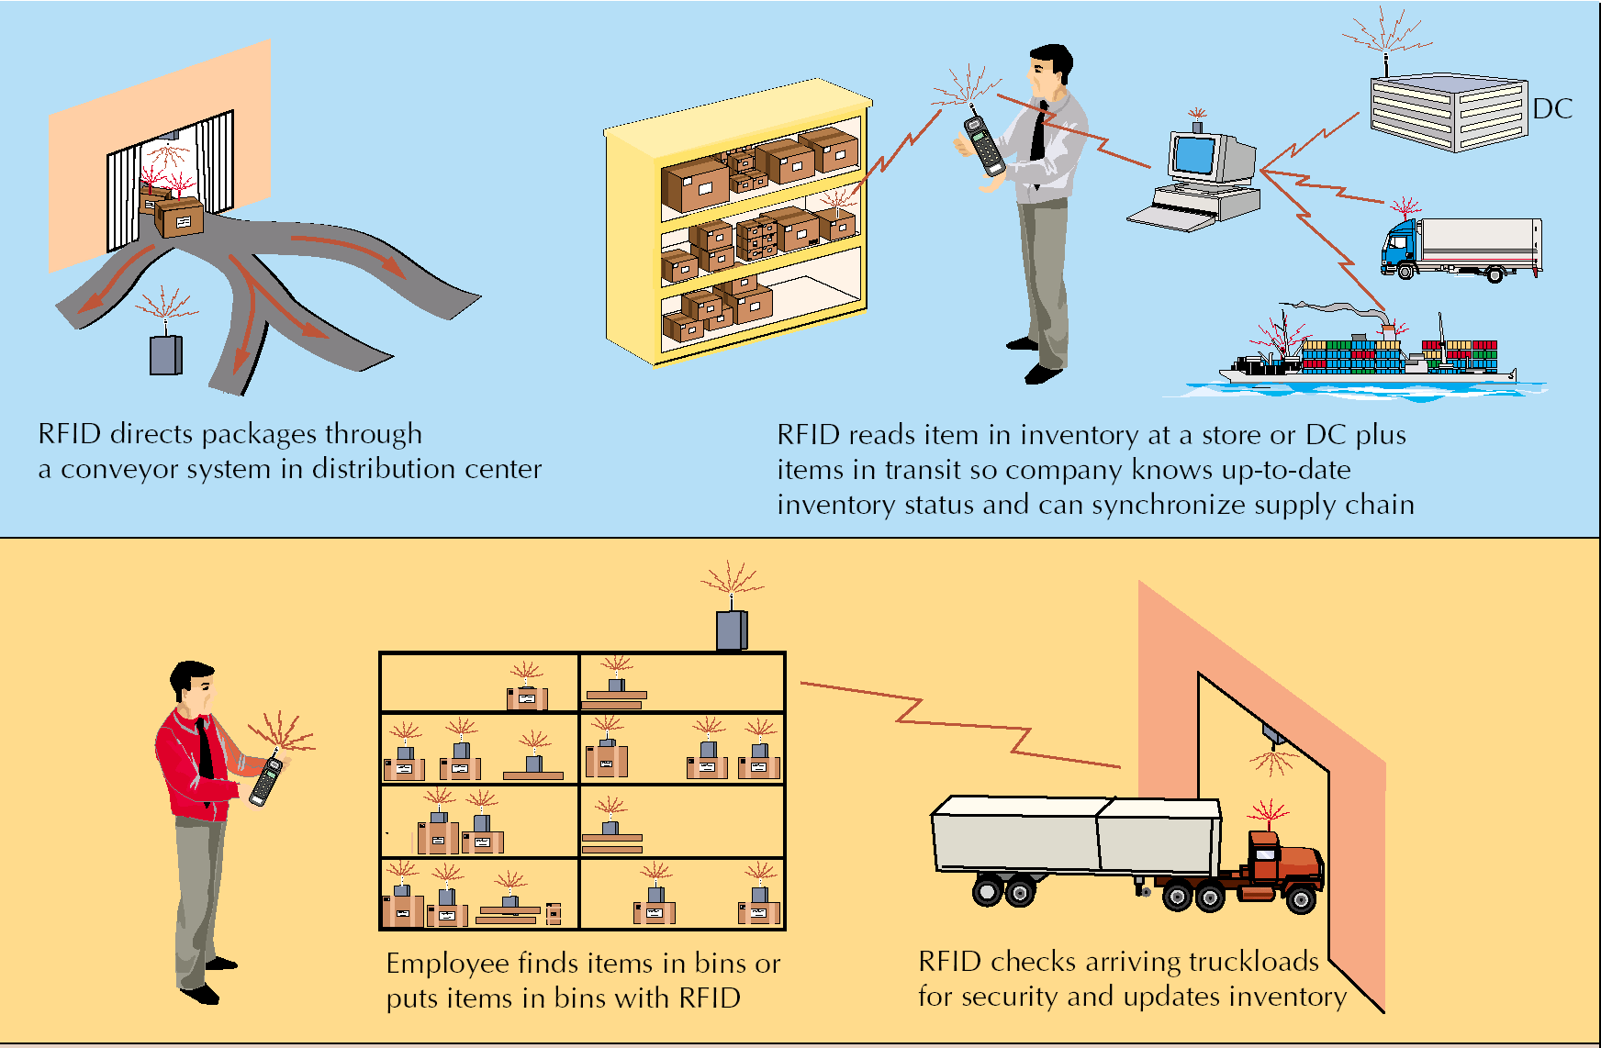
RFID

Slide 17
Supply Chain Benefits
Cost savings and price reductions
Reduction or elimination of the role of intermediaries
Shortening SC response and transaction times
Gaining a wider presence and increased visibility for companies
Wider range of choices available 24 hours with immediate access to prospective purchase information

Slide 18
Supply Chain Benefits
Improved service as a result of instant accessibility to services, accuracy of data
Collection and analysis of voluminous amounts of customer data and preferences
Provides fraud, theft loss protection - electronic payments easier to audit and monitor
Gaining global access to markets, suppliers, and distribution channels
Efficiently obtaining competitive bid information - easier to negotiate price and delivery terms

Slide 19
Duties and Tariffs
Proliferation of trade agreements
Group members charge uniform tariffs
Member nations have a competitive advantage within the group
Trade specialists - include freight forwarders, customs house brokers, export packers, and export management and trading companies
Tariff (customs duty, duty)
  Tax levied on products as they enter a country

Slide 20
Summary
Supply Chain - all stages involved directly or indirectly in fulfilling customer request
SCM - Managing the flow of information through the SC to attain synchronization to make it responsive to customer needs while lowering costs
Bullwhip Effect - fluctuations in orders increase as they move up the SC from retailers to wholesalers to manufacturers to suppliers

Slide 21
Review Questions
Explain Supply Chain
Describe the importance of SCM
What is the meaning of Bullwhip Effect

Slide 22

Question and Answer Session
Question and Answer Session
Q & A

Slide 23
What We will Cover Next
Question and Answer Session
Supply Chain Management II

